Slide 1
Boggle
Anvitha Aluri, Jessica Peng, and Alanna Zhou

Slide 2
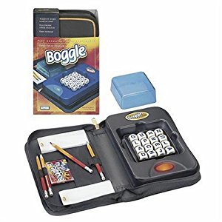
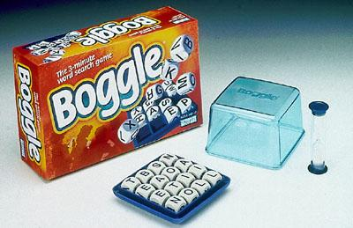
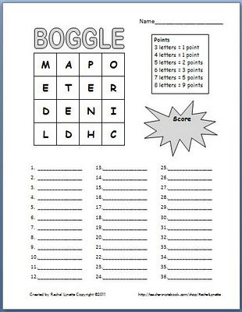
What is Boggle?

Slide 3
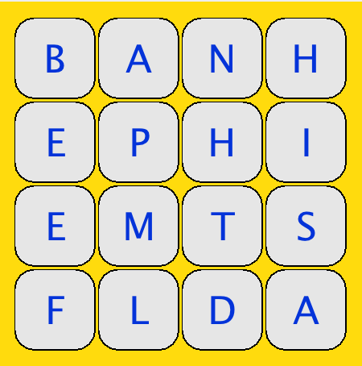
How the game works
4 x 4 grid
16 cubes
objective: find most # of words in 1 minute
at least 3 letters in a word
no repeating cubes in a word
singular and plural forms are counted as 2 words

Slide 4
Use of Data Structures

Slide 5
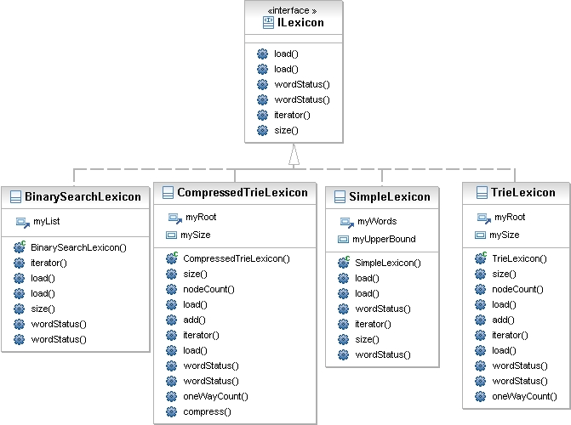
lexicon
How do we ensure that a word is a valid word in the dictionary?

Slide 6
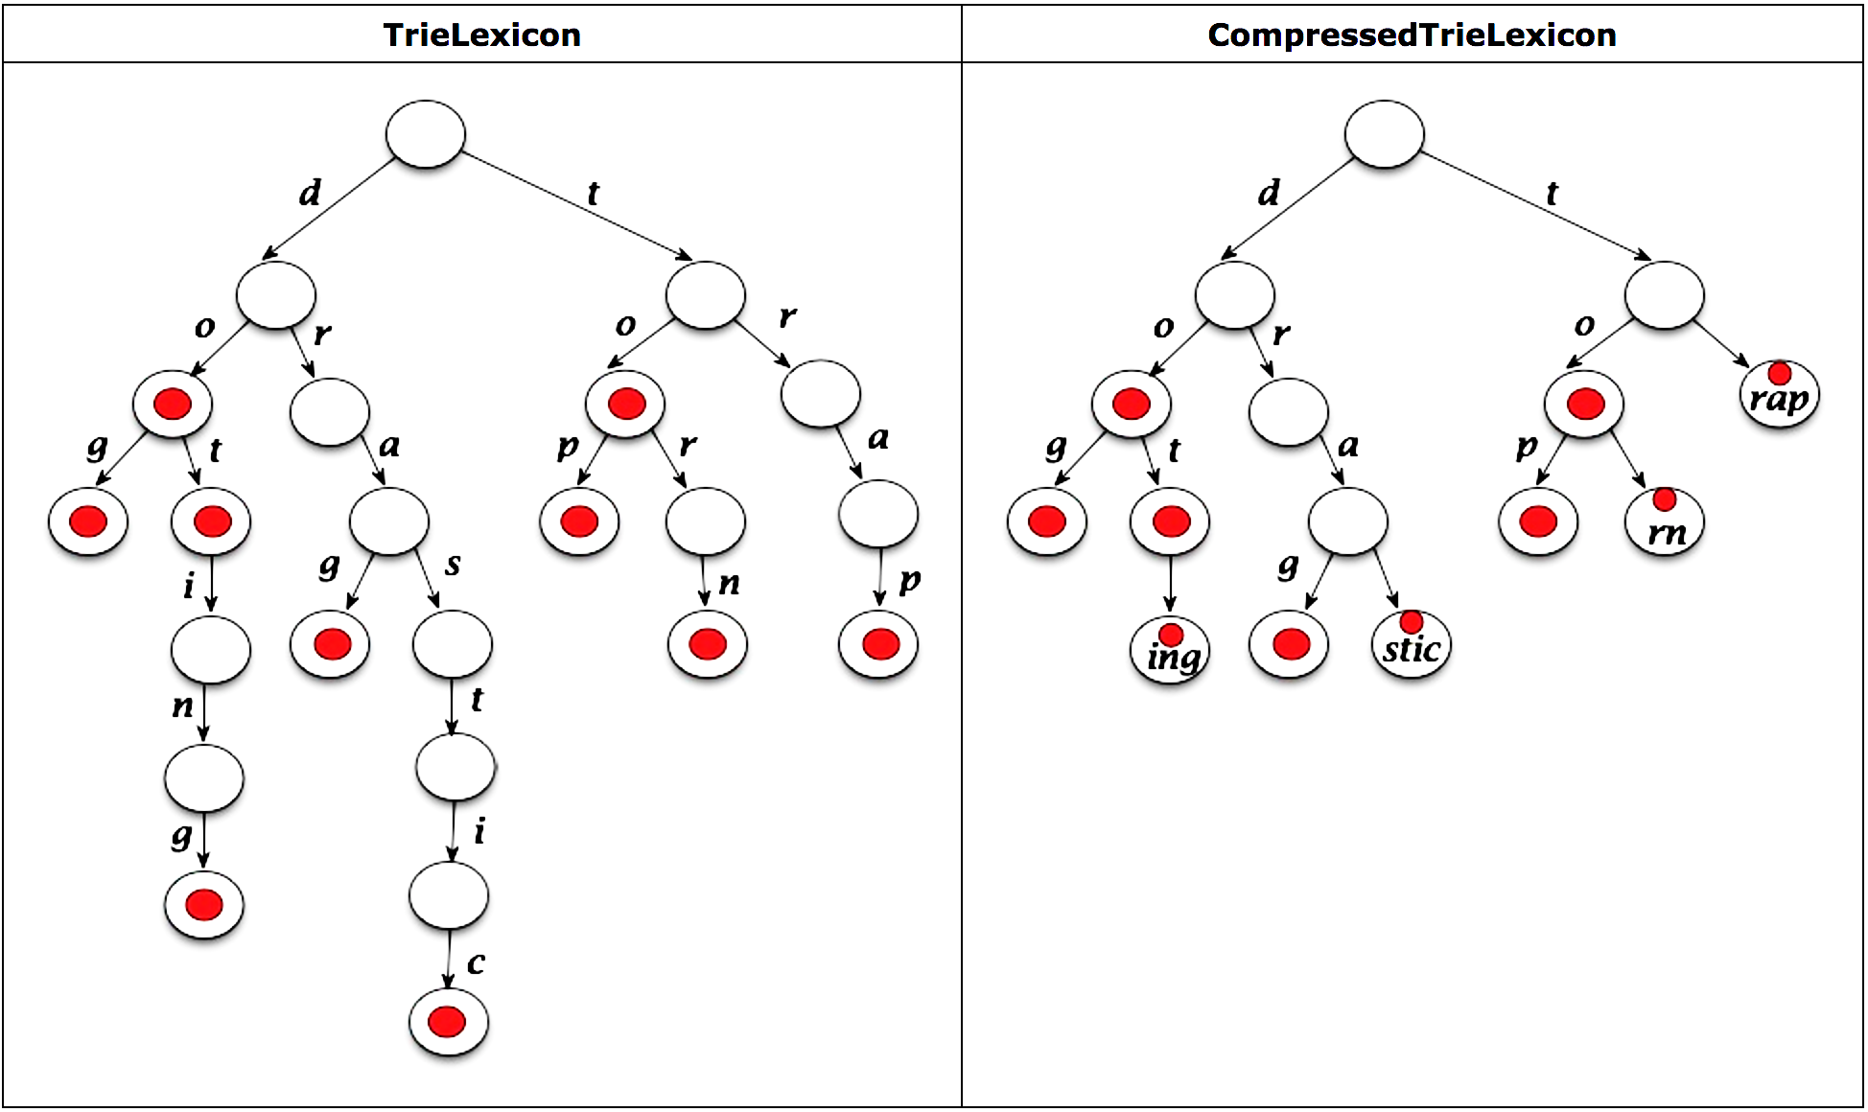
Compressedtrielexicon
Use of maps
Benefits
More run-time efficient
More space efficient

Slide 7
Why Our Boggle?

Slide 8
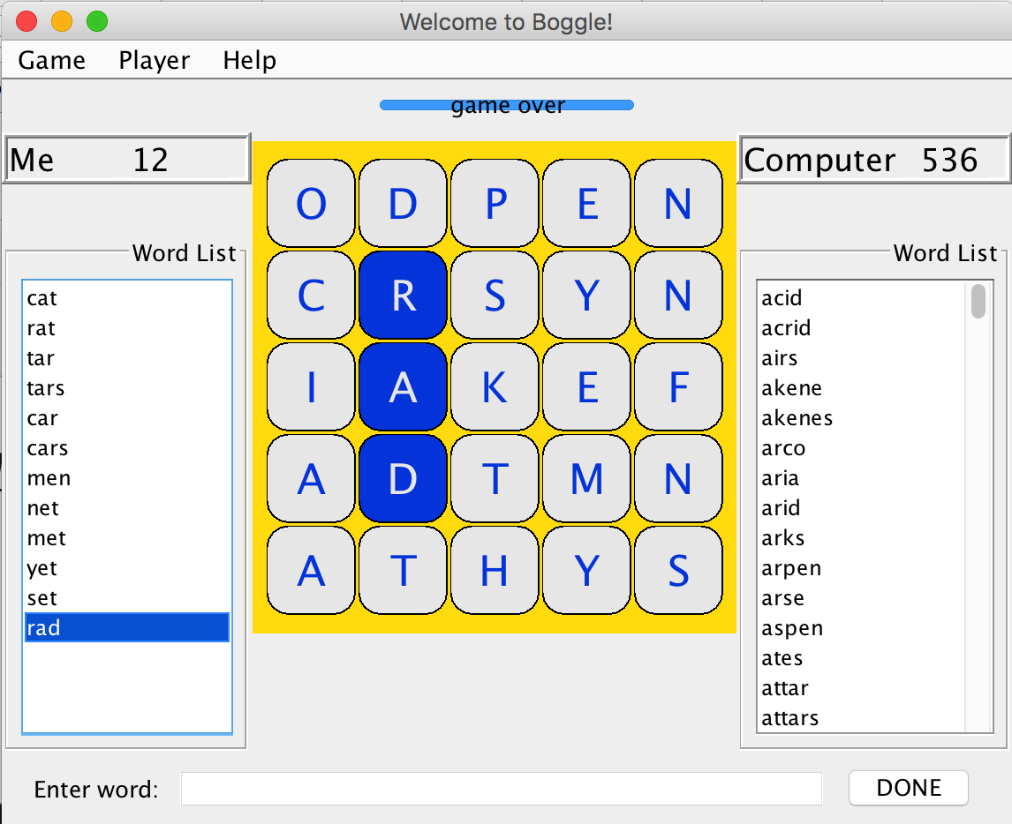
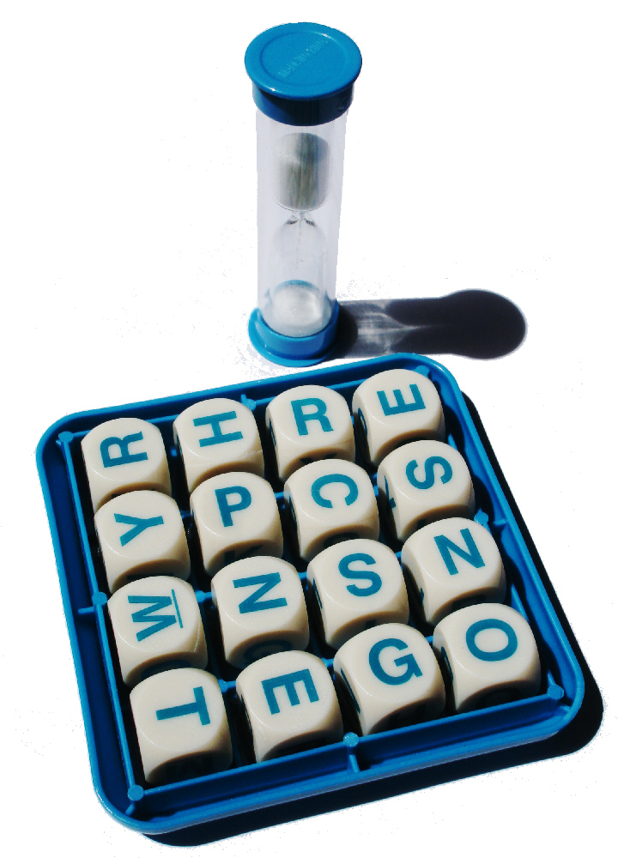
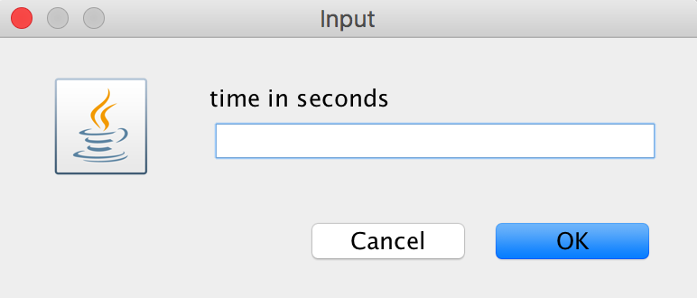
Customizable
board size: 4x4 or 5x5
time

Slide 9
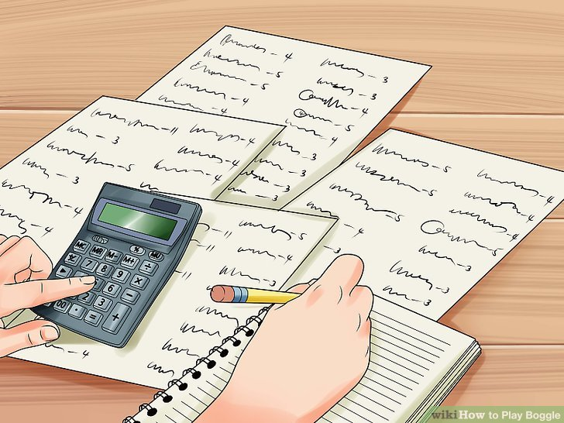
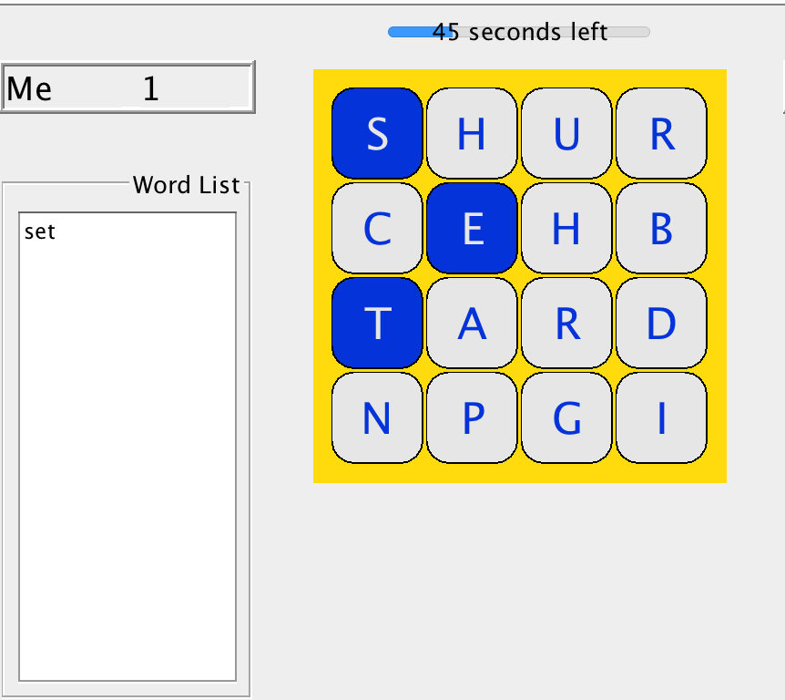
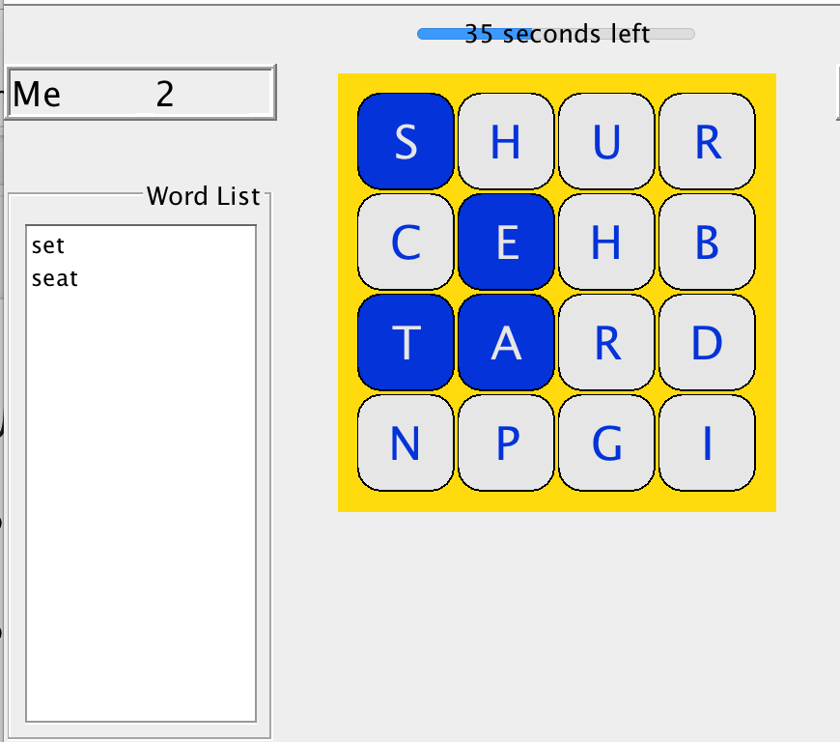
Quicker
board automatically randomizes
scoring as you go

Slide 10
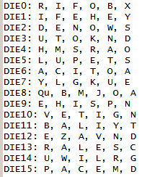
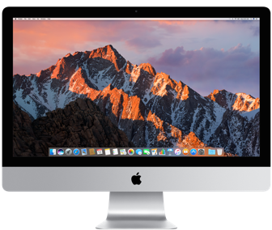
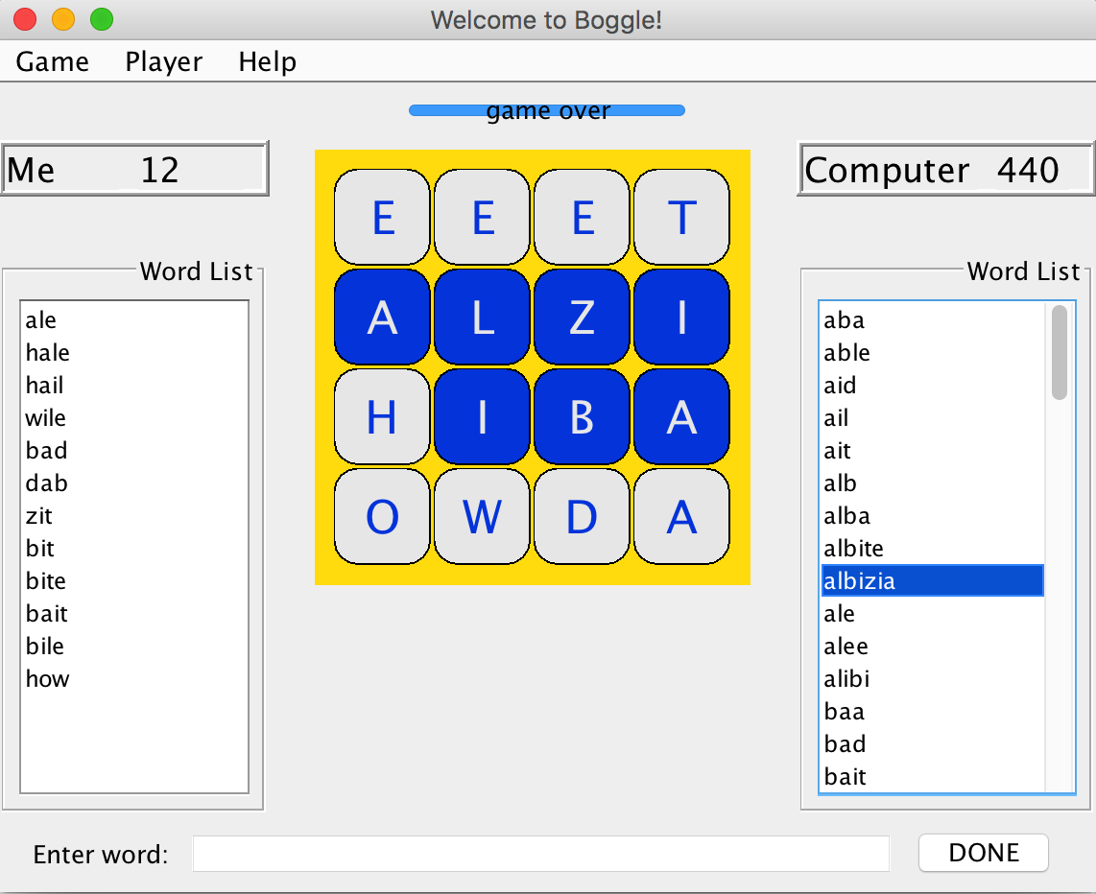

Endless
Unique boards
vs

Slide 11

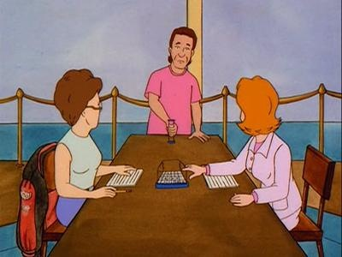
Computer PLayer
Challenge yourself

Slide 12
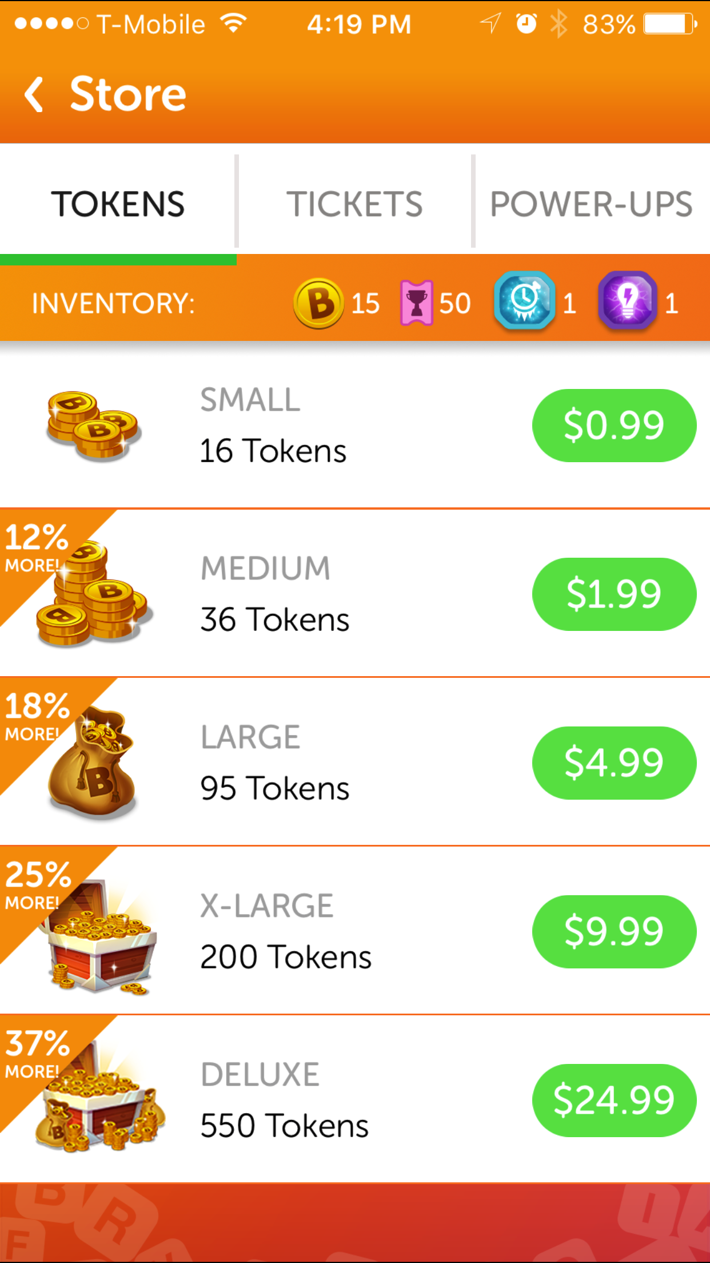
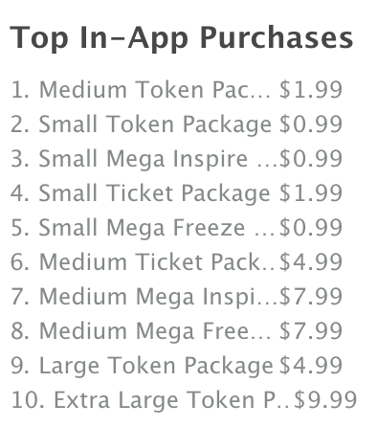
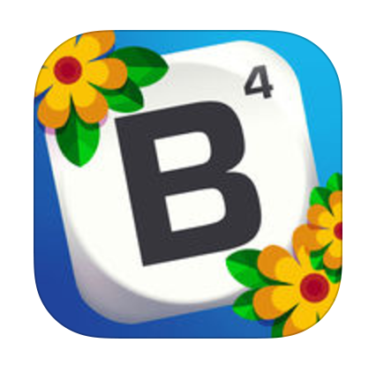
Free

Slide 13
Demo

